Slide 1

GOOD MORNING GRADE 4B
PLEASE LISTEN CAREFULLY TO THE FOLLOWING SOUND BYTE!

Slide 2
GRADE 4B
Social Science=History
Miss S. Abderoef
ISLAM

Slide 3
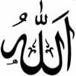
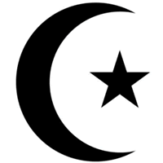

What is Islam?
The word Islam means total obedience to God, whom Muslims call Allah.
A follower of Islam is known as a Muslim.
Muslims believe that Allah revealed the Qur'an to Muhammad, the final prophet.
The Qur'an and the Sunnah form the teachings of Islam.
The Sunnah are the words and actions of Prophet Muhammad.
Muslims are required to observe the Five Pillars of Islam.

Slide 4
The Five Pillars of Islam.
Shahaadah / Testification = Bearing witness to the unity of Allah
Salaah = Praying 5 times a day
Zakaah = Compulsory Charity
Saum = Fasting in Ramadaan
Hajj = Pilgrimage, at least once in your life-time if you can afford it.

Slide 5
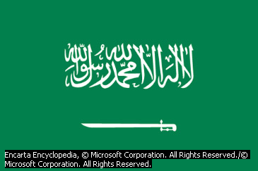
1. The Kalimah/ Testification
I bear witness that there is no god but Allah and that Muhammad is the Messenger of Allah.

Slide 6
2. SALAAH: Five times daily Prayer
Muslims pray/Salaah 5 times a day.
These prayers are compulsory; they must be done.
Muslims face the Kaabah in Makkah when they pray/Salaah.

Slide 7


3. Zakaah – Charity for the poor
The Zakaah is a compulsory charity that Muslims give once a year.
This should not be confused with other charities that can be given at any time.

Slide 8
4. SAUM: Fasting in Ramadaan
Muslims fast from dawn to sunset during the Holy month of Ramadaan.
Ramadaan is the 9th month of the Muslim Calendar.

Slide 9
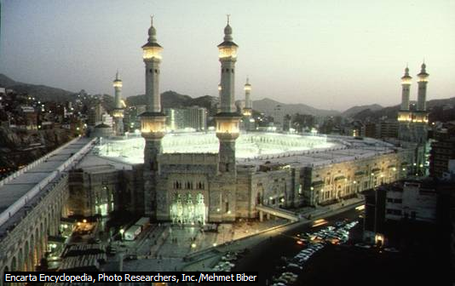
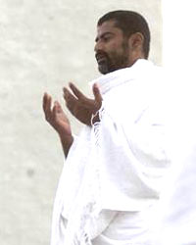
Pilgrimage to Makkah
Al-Haram Shareef in Makkah
Pilgrim in Ihraam
The Kaabah

Slide 10
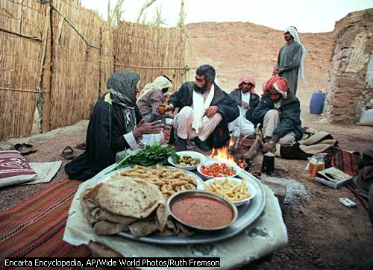
Muslim Festivals
Festival of Charity
This is known as Labarang or Eidul-Fitr.
The fasting of Ramadaan ends with the festival of Eidul-Fitr or Labarang.
Muslims attend Eid prayers at the mosque.
Muslims also wear beautiful
new clothes on this day.

Slide 11
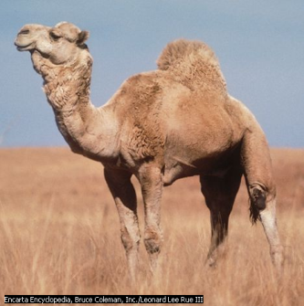
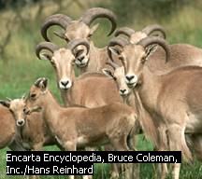
Festival of Sacrifice
This festival is also known as Eidul-Adhaa.
It celebrates the end of the Hajj, or pilgrimage to Makkah.
An animal may be offered as a sacrifice .
Sheep, goats, cows or camels are sacrificed.
Muslims not on pilgrimage celebrate Eidul-Adhaa in their own homes and attend prayers at the mosque.

Slide 12

SYMBOLS OF ISLAM
The symbol of Islam is a crescent moon and star.

Slide 13
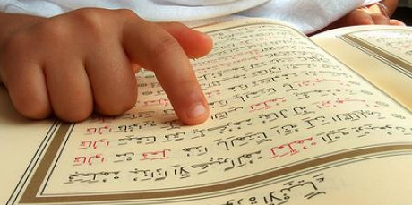
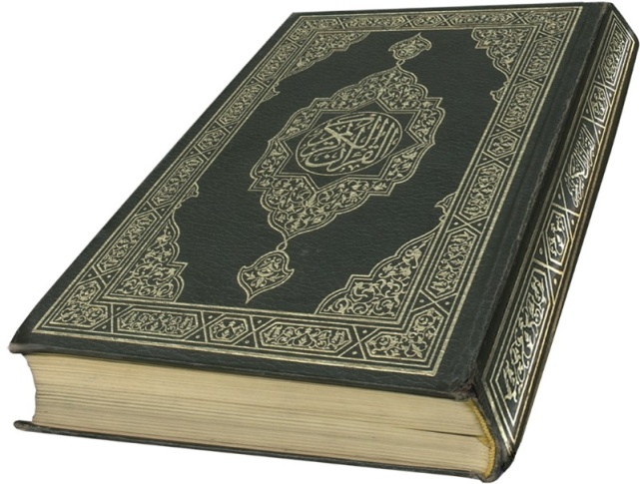

THE HOLY BOOK OF ISLAM
Islam’s Holy Book is the Quran.
It is written in Arabic, but is translated into English, Afrikaans, Zulu and many other languages.
Only some chapters and verses are ready in Xhosa.

Slide 14

THE LEADER OF ISLAM
The leader of Islam is called an Imam.
The Imam leads the prayer or Salaah in the
mosque or Masjid.
He also gives the sermon on a Friday.

Slide 15
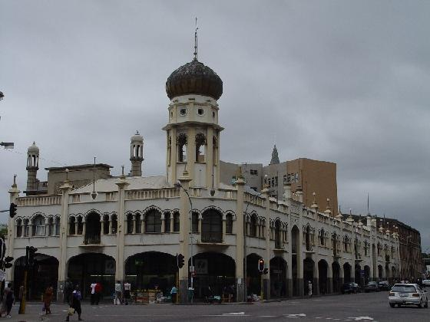
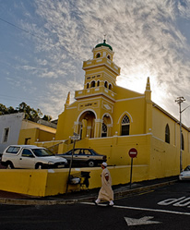
ISLAM’S PLACE OF WORSHIP
Muslims worship in a Mosque or Masjid.
The Imam leads the prayer in the mosque.
DURBAN CAPE TOWN

Slide 16
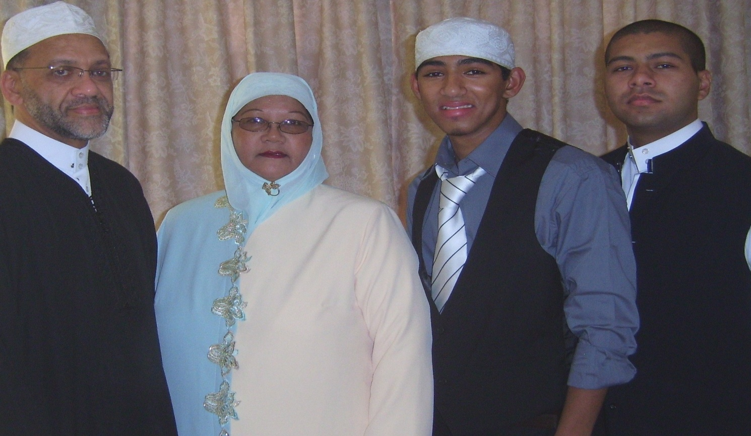
FOLLOWERS OF ISLAM
The followers of Islam are called Muslims.
A Muslim family

Slide 17
LETS REVISE
Islam means _______________
Someone who follows Islam is called a
_____________
3. Islam has _____________ pillars.
4. Mention the pillars of Islam: __________
____________ ____________ _________
____________
5. Muslims worship in a ______________

Slide 18
LETS REVISE
6.

Slide 19
This powerpoint was kindly donated to
www.worldofteaching.com
Home to well over a thousand free powerpoint presentations submitted by teachers. This a free site. Please visit and I hope it will help in your teaching

